Slide 1
string > html file
Write a program that asks the user for their name
then creates a html file that displays their name
You will need to use this command at the terminal:
go run yourfile.go > index.html
this will run your code and output the results to an html file

Slide 2
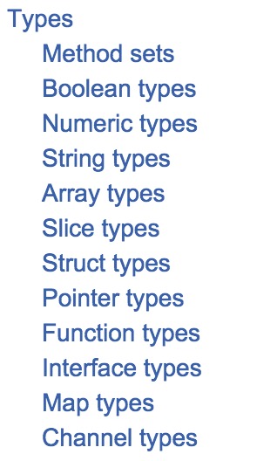
https://golang.org/ref/spec

Slide 3
https://golang.org/ref/spec

Slide 4
https://golang.org/ref/spec

Slide 5
https://golang.org/ref/spec

